Slide 1
Development of a Knowledge Graph Based Integrated Database for Bioresources
Tatsuya Kushida, Daiki Usuda, Toyoyuki Takada, Hiroshi Masuya
tatsuya.kushida@riken.jp
Integrated BioResource Information Division,
RIKEN BioResource Research Center (BRC)
ANRRC 2024
September 4, 2024

Slide 2
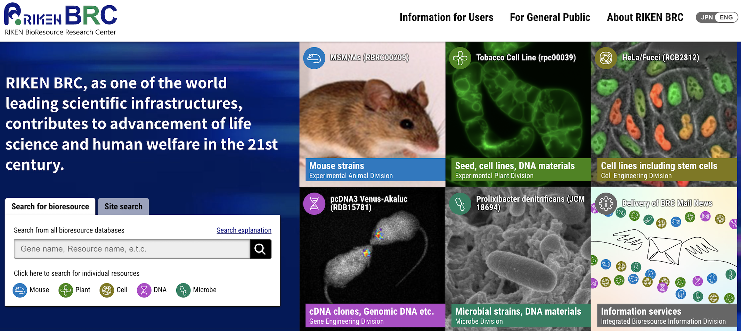
About RIKEN BioResource Research Center (BRC)
Mission
Core competence
Contribute to the development of human health, medical science research, breeding, and production of useful chemical compounds through the RIKEN bioresources.
Simultaneously provide the different types of bioresources.
Experimental animals (>6,000, e.g., gene-modified mice)
Experimental plants (>610,000,
e.g., Arabidopsis c-DNA clones）
Cell materials (>9,000, e.g., iPS cells derived from patients
Information division
(Our Lab).
DNA materials (>160,000, e.g., human cDNA clones)
Microbe materials (>19,000, e.g., Yeast strains)
Activities of Information division
Development of the RIKEN BioResource Graph data (Knowledge Graph).
Integration of this data with external public datasets (e.g., UniProt, ChEBI, DisGeNET, and Disease Ontology).
Storage of the graph data in a triple store, BioResource MetaDatabase (6.8 billion triples).
Implementation of a bioresource retrieval system to explore the bioresources available for life science research and industry.
Notes:
The RIKEN BRC is one of the largest comprehensive bioresource centre.
It provides various types of bioresources such as experimental animals (including genetically modified mice), cell materials (including iPS cells) and DNA materials (including human cDNA clones).
One of our missions is to contribute to the development of human health and medical science research through RIKEN's bioresources.
One of our core competencies is to provide various bioresources simultaneously.
Our information Division carries out the following activities.
We manage information on the bioresources using semantic web technology and provide it to the users.

Slide 3
Development of bioresource graph data (knowledge graph)

Slide 4
Data structure of Graph Database vs Relational Database
Person
Graph database
type
type
type
Alice
Bob
Charlie
works_at
lives_in
works_at
lives_in
works_at
lives_in
Google
California
Amazon
Washington
Microsoft
New York
type
type
type
type
type
type
Company
Residence
Person | Company | Residence
Alice | Google | California
Bob | Amazon | Washington
Charlie | Microsoft | New York
Relational database

Slide 5
Graph Database vs Relational Database - Advantages of Graph Database (green)
Aspect | Graph Database | Relational Database
Schema Flexibility | No predefined schema needed; easily handles complex, evolving data structures. | Rigid schema required; difficult to handle complex relationships.
Ease of Data Insertion | New data and relationships can be added without modifying the schema. | Requires schema modification when adding new data types or relationships.
Query Performance | Optimized for queries involving relationships; efficient traversal of connected data. | Performance may degrade with complex joins or hierarchical data.
Use Cases | Ideal for social networks, recommendation engines, fraud detection, etc. | Best suited for structured data, like financial records, inventory management, etc.
Notes:
The graph database schema is more flexible than the relational database schema.
It is easy to add new data without changing the schema.
In the case of graph database, Because queries involving relationships are greatly optimized, We can efficiently traverse connected data.
The graph database is widely used in social networks and so on, and its superiority has been proven.

Slide 6
Graph Database vs Relational Database - Disadvantages of Graph Database (pink)
Aspect | Graph Database | Relational Database
Maturity | Still relatively new; less mature than relational databases. | Highly mature and well-established technology.
Tooling and Ecosystem | Limited tools and ecosystem support. | Rich set of tools, libraries, and community support.
Performance on Simple Queries | May not perform as well on simple, flat queries. | Optimized for simple, structured queries.
Data Consistency | Ensuring consistency across distributed nodes can be challenging. | Strong consistency models, well-supported by most systems.
Notes:
Because the graph database is still relatively new, graph database is less mature the relational database.
Because of same reason, the tools and the support are limited.
In case of the graph database, simple and flat queries are not well optimized.
Ensuring consistency across distributed nodes can be challenging.

Slide 7
BioResource Schema Ontology (BRSO)
The Biological Resource Schema Ontology (BRSO) is a graph data model for various model organisms and the types, such as individual (mouse, plant, microbe), cell, and DNA, which is largely developed by the Database Center for Life Science (DBCLS), RIKEN, and National Institute of Genetics (NIG). RIKEN BRC is developing bioresource graph data based on the BRSO.
https://github.com/dbcls/brso
Examples of properties (edges) of BRSO
Property | Domain | Range
http://purl.jp/bio/10/brso/deposited_by | Bioresource | Depositor
http://purl.jp/bio/10/brso/sampled_from | Bioresource | Location
http://purl.jp/bio/10/brso/donor | Bioresource | donor
http://purl.jp/bio/10/brso/organism | Bioresource | organism
http://purl.jp/bio/10/brso/genomic_feature | Bioresource | genomic segment
http://purl.jp/bio/10/brso/derived_from | Bioresource | Anatomical part
http://purl.jp/bio/10/brso/has_genomic_segment | genomic segment | gene
http://purl.jp/bio/10/brso/has_allele | genomic segment | allele
Notes:
This table shows BRSO property (edge) example. For example, the domain and range of brso:donor are Bioresource and donor respectively. So far, BRSO has defined about 20 properties.

Slide 8
Bioresource Graph Development
Data structure of gene and phenotype of Experimental Plants using BRSO (extracted)
brso:GenomicSegment/At1g65620
rdfs:seeAlso
ncbigene:842873
brso:has_genomic_segment
dct:identifier
At1g65620
brso:genomic_feature
obo:RO_0002162
obo:NCBITaxon_3702
rdfs:label
AS2
brso:organism
rdf:type
sio:SIO_010000
psi00001
rdfs:label
bioresource:psi00001
dct:identifier
Arabidopsis thaliana
rdfs:label
iso-1D
skos:altLabel
シロイヌナズナ
sio:SIO_001279 (has phenotype)
foaf:homepage
rdf:type
rdfs:label
sio:SIO_010056
phenotype
rdfs:label
Dwarf
https://plant.rtc.riken.jp/resource/psi/psi_detail.html?brcno=psi00001
Notes:
This slied is RDF schema for Experimental Plants data using BRSO . As in the case of mouse, plant resources are linkd to NCBI genes via brso:genomic_feature, has_genomic_segment, rdfs:seeAlso dct:identifier, and rdfs:label.

Slide 9
Data structure of DNA sequence data using BRSO (extracted)
Bioresource Graph Development
Base sequence
GenBank
CCGAAAGAAAATGGCCGCAATTACAT…
brso:genomic_feature
rdfs:seeAlso
rdf:value
bioresource:pda16953
brso:GenomicSegment/RAFL04-10-A08
nucleotide:AK226194
dct:identifier
brso:has_genomic_segment
AK226194
nucleotide: AT1G76100.01
dct:identifier
AT1G76100.01
dct:identifier
Ensembl Plants
RAFL04-10-A08
Notes:
This slide shows the data structure of DNA sequence data. DNA resources are linked to base sequence data via the brso properties genomic_feature, has_gernomic_segment, rdfs:seeAlso and node GenBank and the rdf:value property.

Slide 10
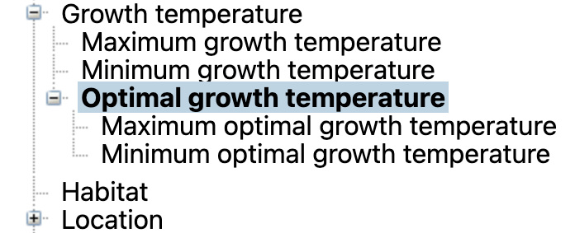
Bioresource Graph Development
Data structure of culture condition for Microbe materials using BRSO (extracted)
Culture condition
optimum growth temperature
degree Celsius
has unit
culture condition
obo:UO_0000027
sio:SIO_000221
mccv:MCCV_000073
mccv:MCCV_000014
rdf:value
bioresource:JCM_2104
25
mccv:MCCV_000018
rdf:type
gm:JCM_M30
growth medium
mpo:MPO_00102
Microbial Phenotype Ontology (MPO)
Notes:
Bioresource JCM_2104 is one of the microorganism resources. It has several culture conditions, such as optimum growth temperature, and growth medium. In the case of optimum growth temperature, Using blank node, BRSO describes the value 25 by rdf:value property, and the unit degree celsius by sio:has_unit property.

Slide 11
Data integration

Slide 12






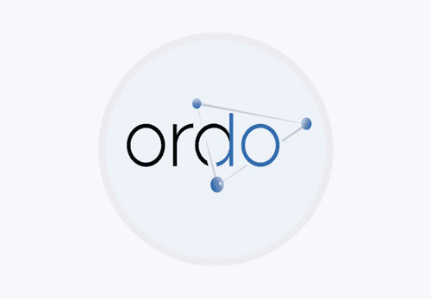
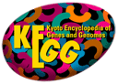



Data integration
Integration of RIKEN mice data with human disease ontologies
RIKEN BioResource RDF (Graph)
Malignant melanoma
Upper DOID
Label@en
Disease Ontologies
Mouse resource
GenomicFeature
Synonym@en
DOID:0050687
RBRC09730
Gene
melanocytic neoplasm
DOID
Mouse Genome Informatics
MGI Gene
DOID:1909
Label@en
Upper MONDO
Label@en
Braf(MGI:88190)
Synonym@en
Synonym@en
固形腫瘍
MONDO:0021143
NCBI mouse Gene
Braf(NCBIGene:109880)
Upper NANDO
Label@en,ja
Naevocarcinoma
悪性黒色腫
Synonym@en,ja
NAND:2100006
OMA
MedGen
(or DisGeNET)
MONDO
NANDO
Label@en,ja
Label@en
NADO:1200002
Synonym@en,ja
Human Gene
Synonym@en
melanoma
MONDO:0005105
Upper ORDO
Label@en
BRAF(NCBIGene:673)
melanoma
ORDO
ORDO:C048
Synonym@en
OMA Ortholog
ORDO:411533
Label@en
Solid tumor
Synonym@en
exactMatch
medgen:C0025202
MeSH
KEGG
KEGG:H00038
Upper KEGG
Label@en,ja
closeMatch
MESH:D008545
KEGG:H02421
Synonym@en,ja
Gene-Disease Association
Label@en,ja
ICD-11
subClassOf
Synonym@en,ja
ICD-11:2C30
others
ICD-11
Collecting
Keyword retrieval system to explore the bioresources relevant to human diseases
Reuse
Bioresource-disease associations
Notes:
This section is the RIKEN Bioresource graph. The graph is linked to disease ontologies via the MGI RDF, OMA Ortholog RDF and Gene-Disease Association RDF. By navigating these RDF graphs, we can identify disease-related mice using disease names and IDs. From the integrated RDF graph, we also collect direct bioresource-disease relationships and reuse these relationships to implement a keyword retrieval system for exploring bioresources relevant to human disease.
So, we integrate the bioresource RDF data with external databases such as mouse genome, ortholog, and gene-disease interaction databases and disease ontologies such as human disease ontology, MONDO, and ORDO.
As a result, we could link 26,000 RIKEN bioresources to 500 disease terms through the integrated RDF graph.
The Bioresource-Disease Association RDF data is interpretable RDF data based on biological knowledge from reliable external public databases, such as MGI, OMA ortholog, DisGeNET, and Disease ontologies.

Slide 13



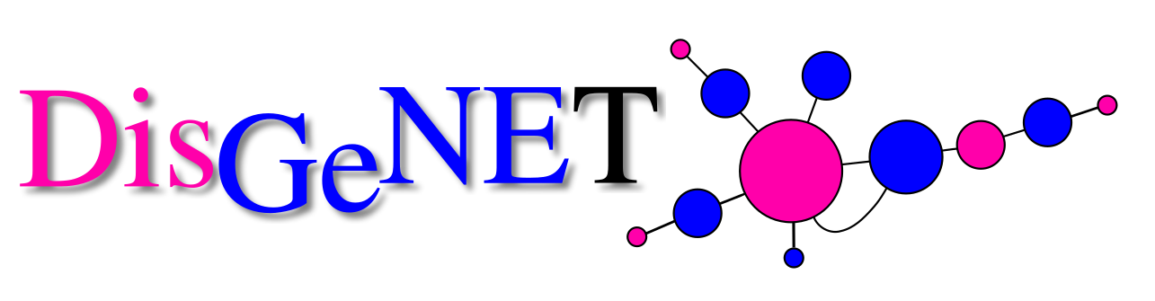
Data integration
Linking a bioresource with disease using multiple databases (Animal)
(An example of mouse resource)
bioresource
RIKEN BRC mouse---> MGI gene
RIKEN BRC Mouse RDF Graph
mouse gene
NCBI Mouse gene <- MGI gene
MGI RDF Graph
mouse gene
NCBI mouse gene <---- Orthologs Cluster --> OMA human protein ->
OMA human gene -> NCBI/Ensembl human gene
OMA RDF Graph
human gene
disease
NCBI/Ensembl human gene <- Gene-Disease Association -> UMLS disease
human gene
DisGeNET RDF Graph
: Graph connection through URI
Notes:
This diagram is a simplified version of the previous one. Each graph is connected by co-existing URIs, such as MGI genes, NCBI mouse genes, and NCBI/Ensembl human genes.
This is an example of linking of a bioresouce with dhisase in mouse

Slide 14
Data integration
Relationships among mice, cell and DNA materials
Orthologs Cluster
OMA Ortholog RDF
Relationships among the RIKEN mice, human cells, and human DNA materials relevant to a disease (e.g., melanoma)
hasHomologousMember
hasHomologousMember
Node1
Node2
Gene-Disease Association RDF
(e.g., DisGeNET)
hasHomologousMember*
hasHomologousMember*
Protein1
Protein2
Gene-Disease Association
is_encoded_by/xrefNCBIGene
is_encoded_by/xrefNCBIGene
refers_to
refers_to
Mouse Gene
Human Gene
Human Disease
e.g., MGI:88190
NCBIGene:109880 (Braf)
e.g., NCBIGene:3565 (BRAF)
genomic_feature/has_genomic_segment/seeAlso
genomic_feature/has_genomic_segment/seeAlso
Cell material
e.g., DOID:1909, MONDO:0002771 (melanoma)
RIKEN BRC Mouse
Mouse
RIKEN BRC Human DNA
RIKEN BRC Human Cell
DNA material
donor
has_disposition/seeAlso
e.g., RIKEN BRC Mouse: RBRC09730
e.g., RIKEN BRC DNA : HGX032820
e.g., RIKEN BRC cell: RCB0808
Donor
RIKEN BioResource RDF
Notes:
These bioresources are connected in the RDF graph. We can simultaneously find disease-related mice, cells and DNA materials using disease names and IDs.

Slide 15
Data integration
Linking a bioresource with chemical data using multiple databases (Plants) 1/2
brso:genomic_feature/brso:has_genomic_segment/rdfs:seeAlso
bioresource
BRC Plant Bioresource RDF Graph
Plant cDNA --> ncbigene
gene
protein
ncbigene <- uniprot -> enzyme
UniProt RDF Graph
rh:ez
rh:side
rh:contains
Rhea RDF Graph
rdfs:seeAlso
enzyme <- reaction -> side -> participant ->
compound-> chebi
uniprot:enzyme
chemicals
chebi --> role
ChEBI Graph
rh:compound
rh:chebi
quality
e.g., anti-inflammatory agent
chebi -> knapsack-> bioactivity
quality
e.g., induce flowering
External public RDF data
KNApSAcK RDF Graph
Licensed under a Creative Commons 表示4.0国際ライセンス ©2022 櫛田 達矢（理研バイオリソース研究センター）
Notes:
Plant cDNA bioresources have NCBI gene information. Bioresource RDF and UniProt RDF data are connected via NCBI genes. UniProt RDF and biochemical reaction RDF Rhea are connected via enzymes. Furthermore, Rhea RDF and chemical substance ontology ChEBI are connected via ChEBI substances. As a result, by navigating these graphs, we can identify bioresources relevant to ChEBI roles, such as anti-inflammatory agent.

Slide 16
Data integration
Linking a bioresource with Gene Ontology using UniProt Graph (Plants) 1/2
brso:genomic_feature/brso:has_genomic_segment/rdfs:seeAlso
bioresource
gene
Plant cDNA ---> ncbigene
BRC Plant Bioresource RDF Graph
UniProt RDF Graph
protein
e.g., cuticle development
ncbigene <- uniprot -> geneOntology
biological process
e.g., progesterone 5-alpha-reductase activity
molecular function
rdfs:seeAlso
cellular component
e.g., chloroplast
External public RDF data
uniprot:classifiedWith
Notes:
UniProt RDF data includes Gene Ontology information. By integrating cDNA bioresources with UniProt RDF, we can identify cDNA materials relevant to Gene Ontology terms, such as cuticle development.

Slide 17




External public data integrated with the bioresource graph data
Category | Datasets | Datasets | Who created graph data (RDF/OWL) | License
Genome /Proteome | 1 | Mouse Genome Informatics (MGI) RDF | RIKEN BRC | Original (... used for research and educational purposes only. Reproduction or use for commercial purposes without the express prior written permission of The Jackson Laboratory is prohibited.)
 | 2 | UniProt RDF (including Gene Ontology) | UniProt | CC BY 4.0
Ortholog | 3 | Orthologous Matrix (OMA) RDF | OMA | CC BY-SA 2.5
Gene-Disease interaction | 4 | DisGeNET RDF | DisGeNET | CC BY-NC-SA 4.0
 | 5 | MedGen RDF | DBCLS | NCBI Website and Data Usage Policies and Disclaimers
 | 6 | KEGG MEDICUS RDF | RIKEN BRC | CC BY-SA 4.0
Disease | 7 | Nanbyo Disease Ontology (NANDO) | DBCLS | CC BY 4.0
 | 8 | Human Disease Ontology (DOID) | DOID | CC0 1.0
 | 9 | Mondo Disease Ontology (MONDO) | MONDO | CC BY 4.0
 | 10 | Orphanet Rare Disease Ontology (ORDO) | ORDO | CC BY 4.0
Phenotype | 11 | Mammalian Phenotype Ontology (MP) | MP | CC BY 4.0
 | 12 | Human Phenotype Ontology (HP) | HP | Original (... vocabularies, annotation files, tools and documentation are freely available. ... is acknowledged and cited properly.
Chemicals | 13 | Chemical Entities of Biological Interest (ChEBI) | ChEBI | CC BY 4.0
Biochemical reactions | 14 | Knowledgebase of biochemical reactions (Rhea) | Rhea | CC BY 4.0
Gene expression | 15 | Bgee: gene expression data in animals | Bgee | CC0 1.0
Notes:
These are examples of the external RDF data integrated with the bioresource RDF data. It includes ...

Slide 18
STATISTICS (No. of bioresources, and triples by bioresource types)
Bioresource type (graph) | No. of resources | No. of resources relevant to human diseases* | No. of relevant human disease | No. of triples (set of a node, an edge, and a node)
Experimental animals (e.g., mice) | 6,295 | 1,623 | 1,295 | 1,004,439
Experimental plants | 612,129 | N/A | N/A | 3,772,663
Cell materials | 9,634 | 215 | 607 | 766,279
DNA materials | 168,387 | 2,470 | 2,333 | 4,915,475
Microbe materials | 19,946 | N/A | N/A | 1,113,745
Total (RIKEN bioresource) | 816,391 | 4,308 | 2,628 | 11,572,601
Total (including external datasets) | N/A | N/A | N/A | 6,803,456,799**
*: Used datasets(DisGeNET-DOID)
**: Acquired from YummyData
Notes:
This table shows the statistics of bioresources and triples by graph datasets. For example, in the case of cell materials, the number exceeds 9,000, and the number of triples exceeds 7 hundred thousands. The total number of resources reaches more than 8 hundred thousand. The total number of triples in the RIKEN bioresources is more than 11 million. The total number of triples, including external datasets, is more than 6.8 billion.

Slide 19
Open triplestore (Graph Database storage)

Slide 20
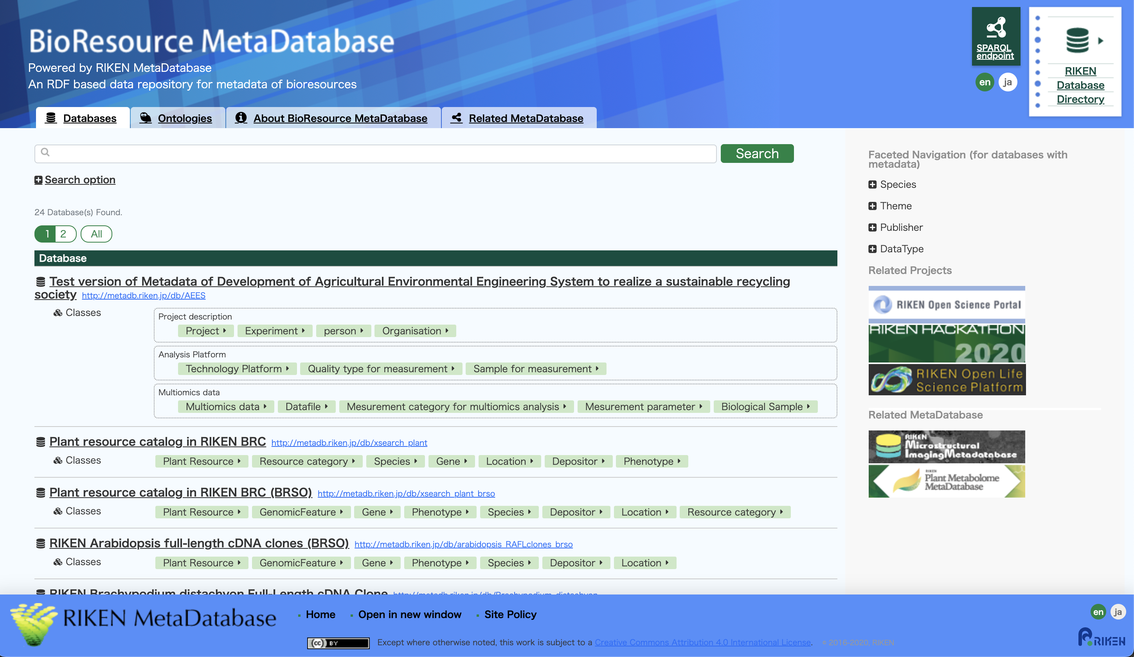
3. Triple store
BioResource MetaDatabase top page
https://knowledge.brc.riken.jp/
SPARQL endpoint
Notes:
We store the Bioresource RDF data in the triple store Bioresource MetaDatabase powered by Virtuoso. This is the Bioresource MetaDatabase page. The SAPRQL endpoint entry is here.

Slide 21
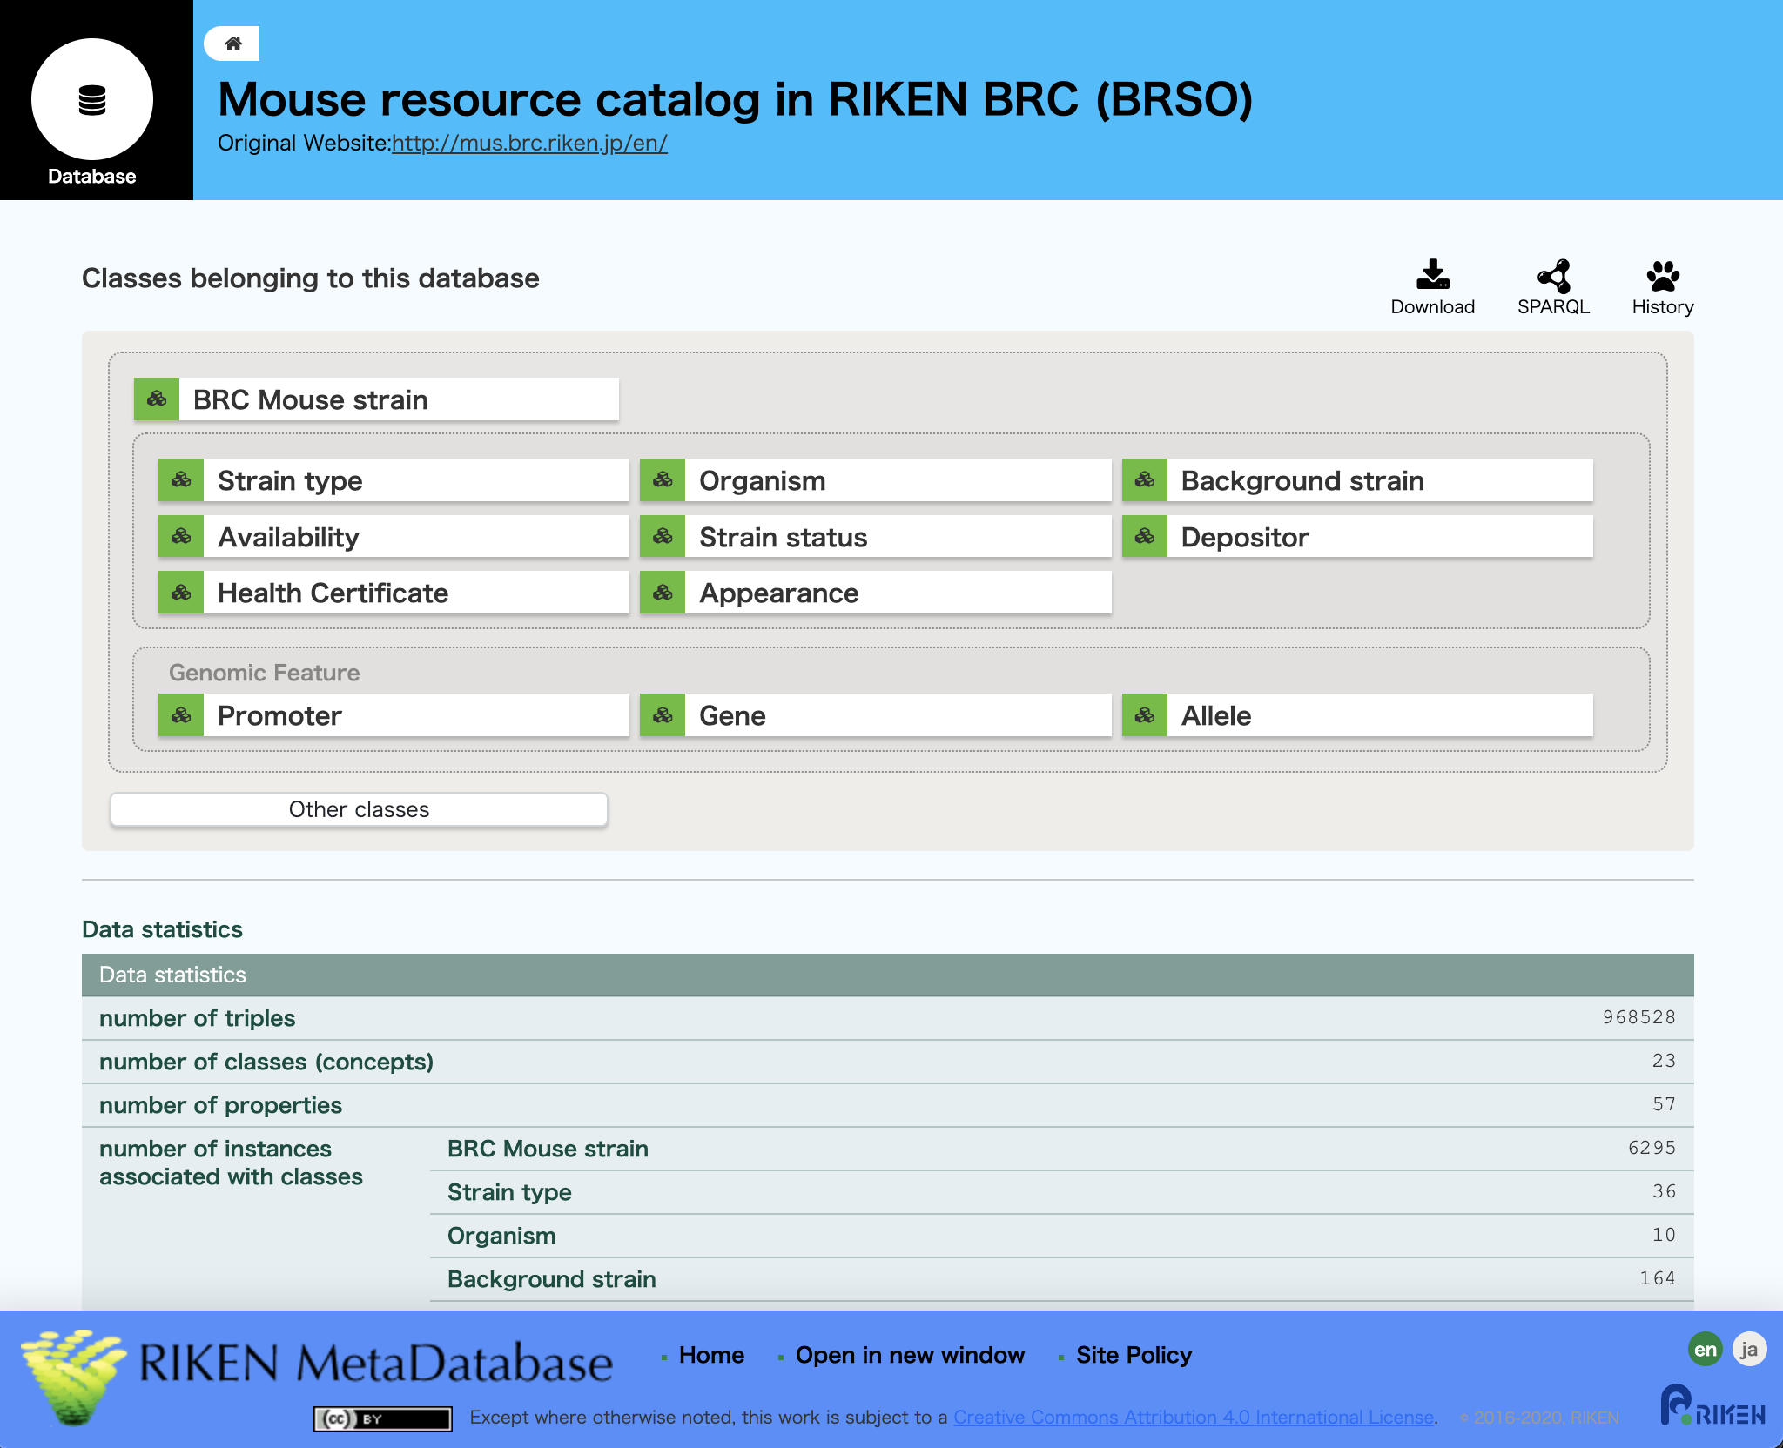
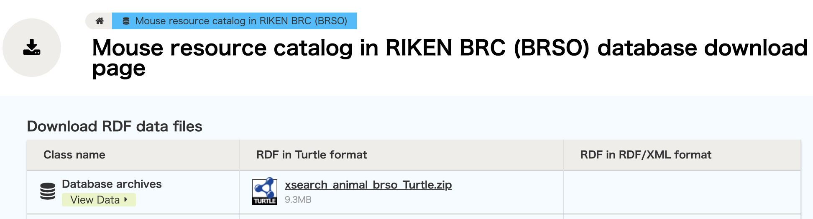
Mouse resource download page
https://knowledge.brc.riken.jp/bioresource/db/xsearch_animal_brso
Download
Graph data
Notes:
All bioresource RDF data can be downloaded from the download page under the CC BY licence.

Slide 22
Implementation of two search systems for https://web.brc.riken.jp/

Slide 23
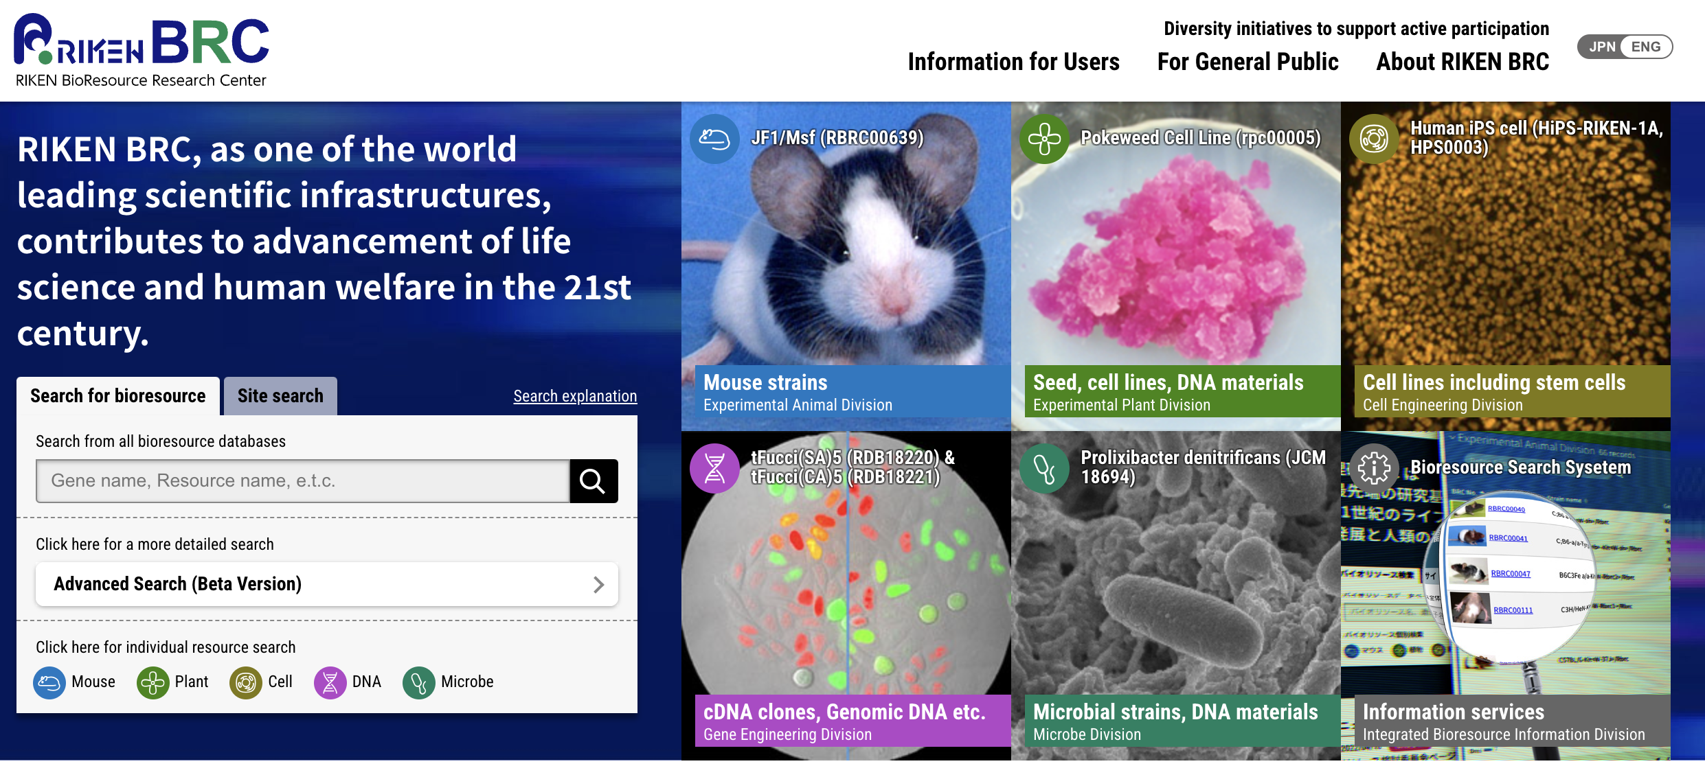
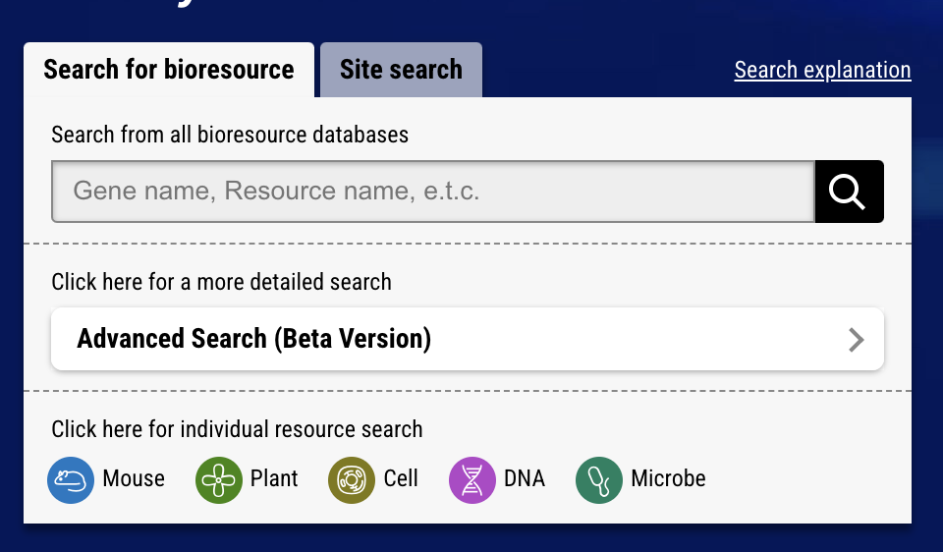
Keyword retrieval system
1. Cross-search system
A simple keyword retrieval system for all RIKEN's bioresources reusing graph data.
at https://web.brc.riken.jp
6,295 mice, 612,129 plants, 9,634 cells, 168,387 DNAs and 19,946 microbes can be retrieved at once.
The knowledge base has biological names for bioresources, species, genes, phenotypes and diseases to support bioresource users for retrieve.
The system is integrated in the BRC top page with search window.
Cross-search window
As the user types, the system presents the resource name, species, disease, phenotype, and gene as possible search terms that match the text.
Notes:
The retrieval system is integrated in the BRC top page with search window.

Slide 24
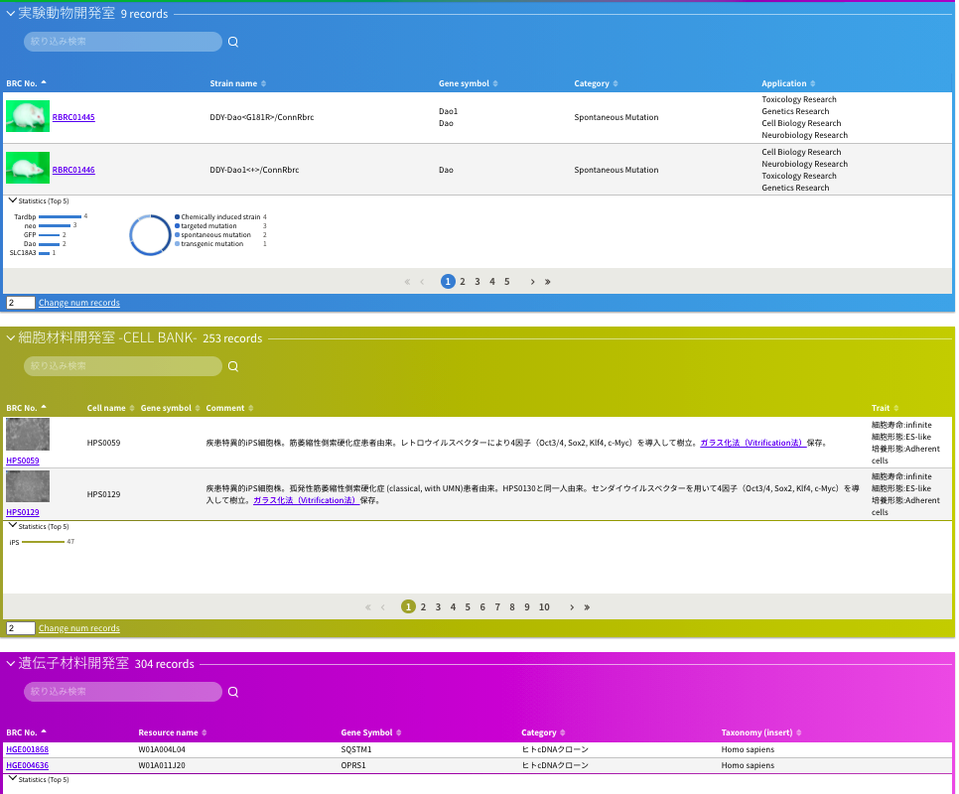
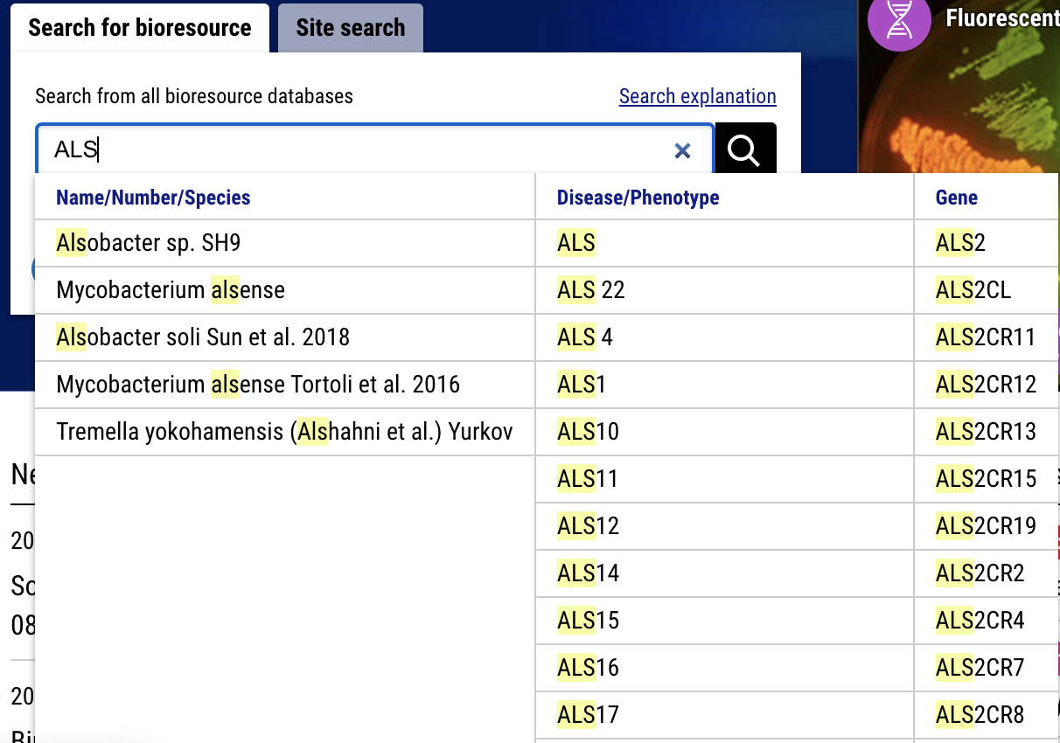
Keyword retrieval system
1. Cross-search system
Function
Perform a keyword search using disease names, gene symbols, phenotypes, resource IDs, and so on.
Support for keyword entry via suggestion lists.
9 mice associated with ALS
Keyword (e.g., ALS)
256 cell materials associated with ALS
Amyotrophic lateral sclerosis (ALS)
筋萎縮性側索硬化症
515 DNA materials associated with ALS
Suggestion list
Select query word
Display search results by resource type, such as mice, cell and DNA materials.
Notes:
As mentioned above, we are implementing a keyword search system for bioresources based on RDF data. Users can perform a keyword search using any disease names and IDs. The system supports keyword entry via suggestion lists. The system displays the search results by resource type, such as mice, cell, and DNA materials.
This example is that the users perform a keyword search using ALS.
The users can get nine mice, 253 cell materials, and 515 DNA materials relevant to ALS by the bioresource types simultaneously.
The system shows suggestion lists by resource's/ disease's/phenotype'S name/ID and gene symbol.

Slide 25
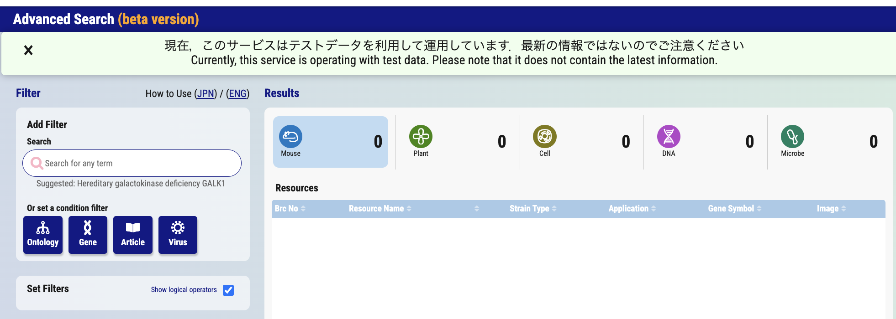
Advanced search system
2. Advanced search system (Beta version)
A novel retrieval system that is functionally enhanced.
at https://web.brc.riken.jp (RIKEN BRC top page)
Interface of the Advanced search system

Slide 26
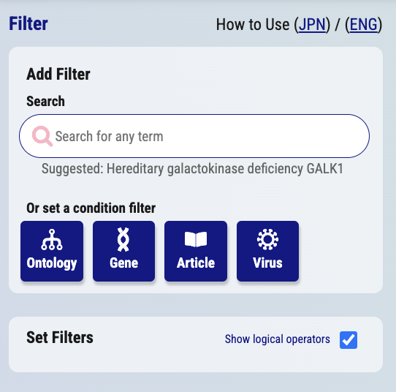
Advanced search system
Features of Advanced Search
Advanced search window
Users can search by category in addition to keyword search for all fields. Currently, categories include ontology, gene, article (PubMed ID), and virus.
In the case of an ontology search, users select multiple ontology terms from the ontology hierarchy and find the relevant bioresources.
During the search process, users can confirm the number of hit bioresources and proceed with the search.
Users can combine multiple search conditions (perform OR/AND search).
Select Ontology search

Slide 27
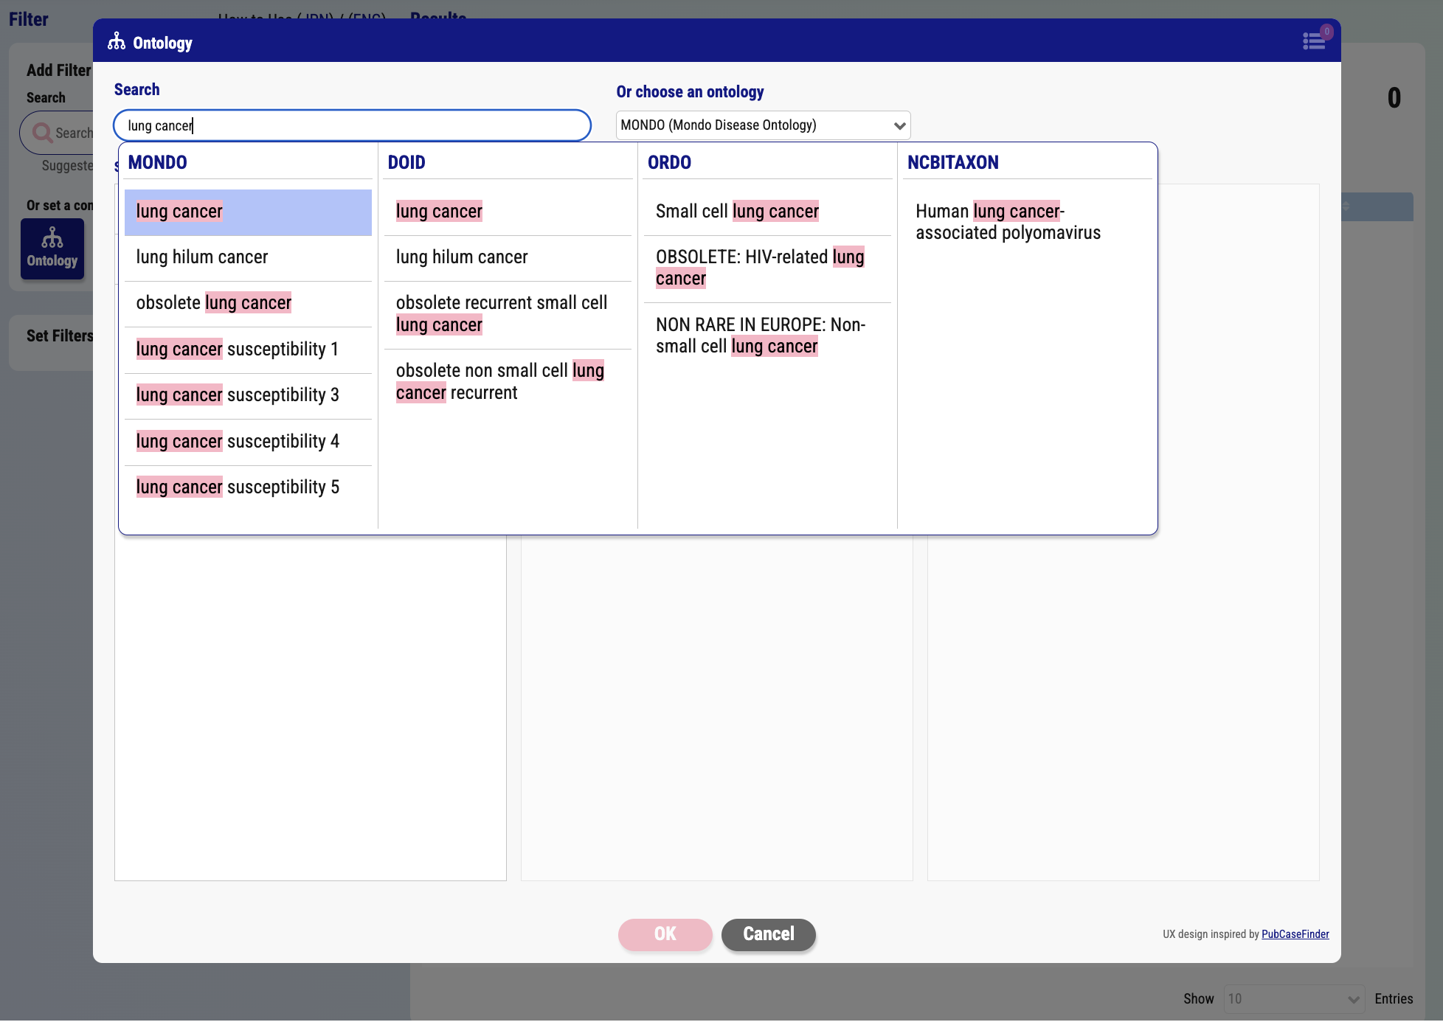
Advanced search system
Type query word (e.g., lung cancer)
Ontology search examples
Select query word from suggestion list
Suggestion list
Press OK button
Ontology search window

Slide 28
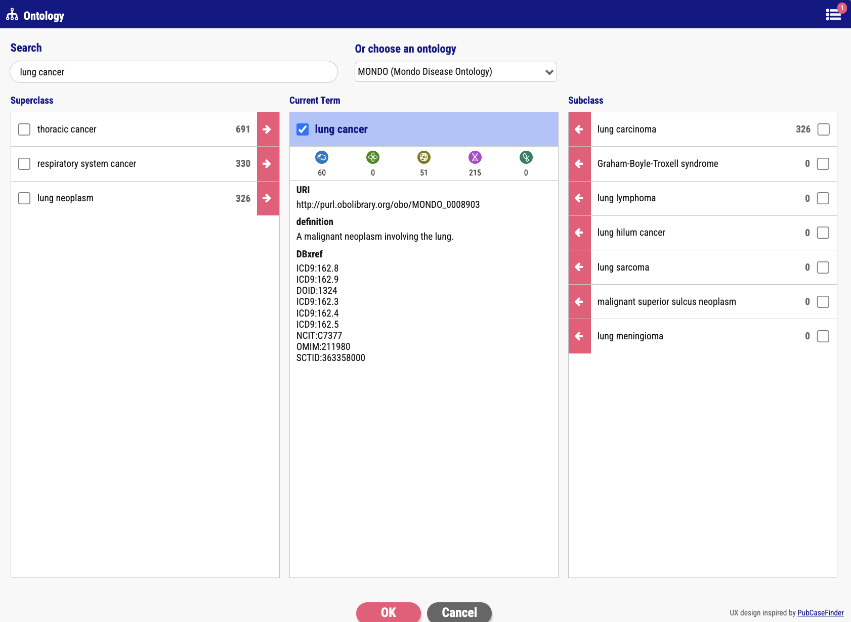
Advanced search system
Ontology search examples
Check query words (multiple selects allowed)
Current term
Superclass
Subclass
System displays the number of the hit bioresources by resource type
Press OK button
Ontology hierarchy window

Slide 29
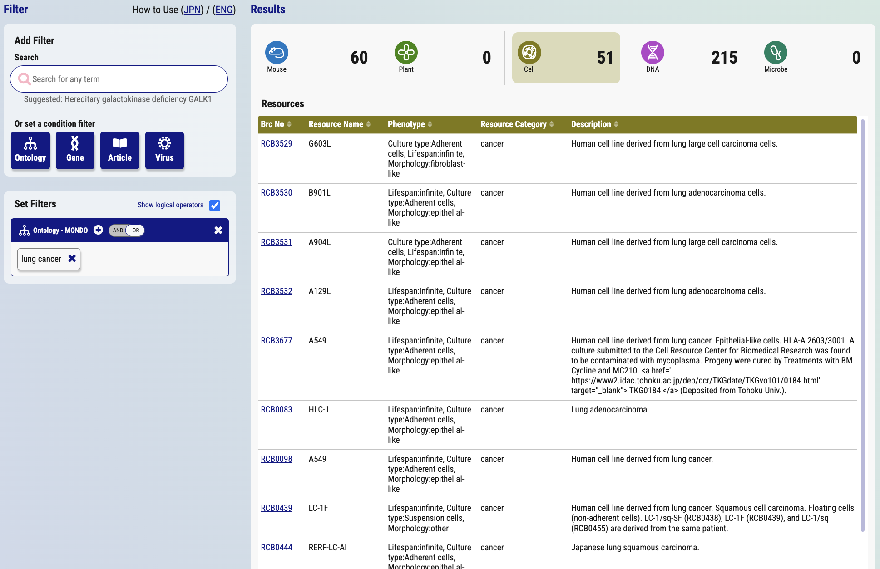
Advanced search system
Select resource type
Ontology search examples
Select a resource
Search results window

Slide 30
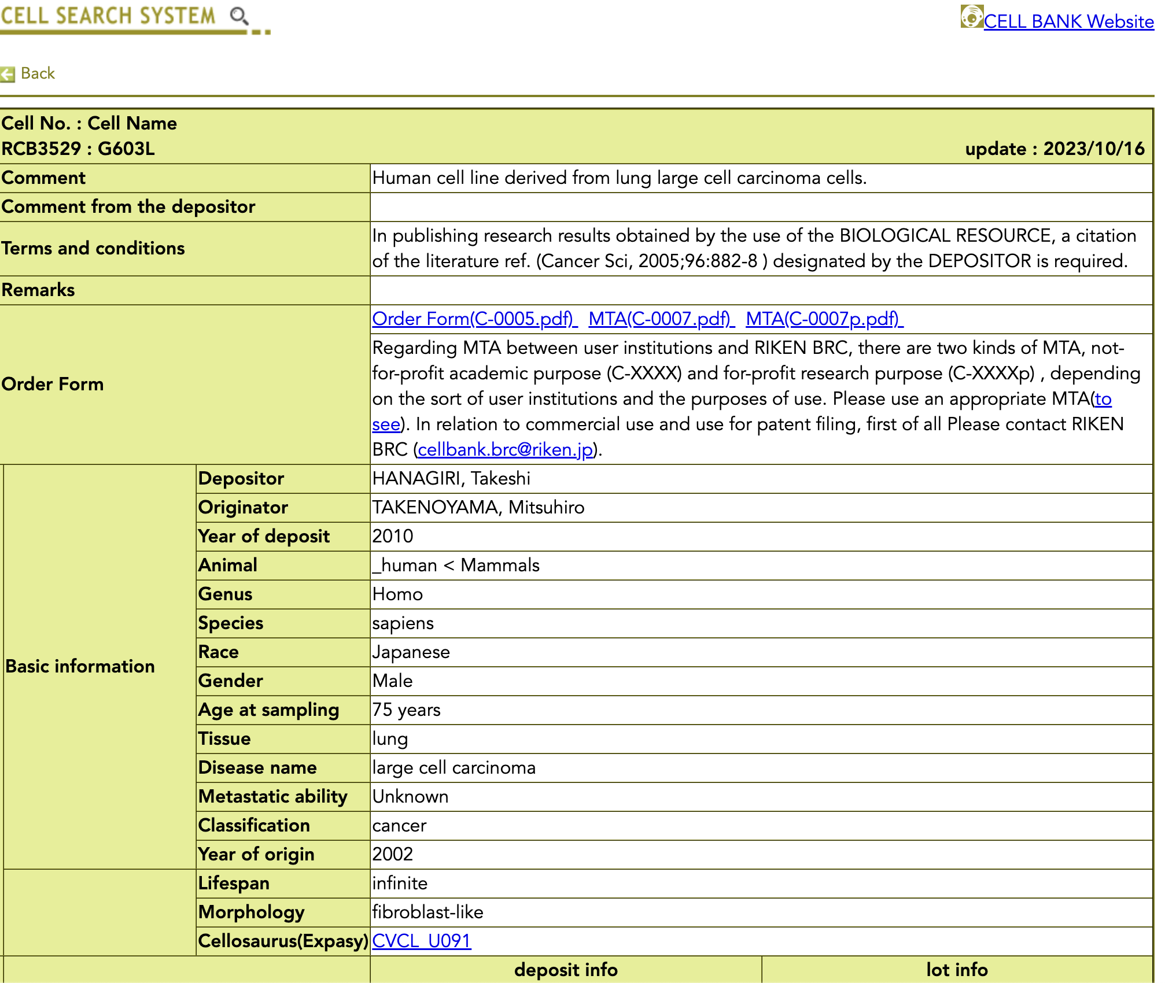
Advanced search system
Ontology search examples
A resource page

Slide 31
Trial of AI search

Slide 32



Trying to use LLM to search for bioresources
Large Language Models
Objectives:
Implement the LLM in the bioresource retrieval system to enable fuzzy search capabilities.
Expected Results:
Enable users to perform more intuitive and flexible queries.
Enhance the overall user experience.
Prevent failures in information retrieval due to user errors, such as typos or misspellings.
Improve search accuracy, with a particular focus on enhancing recall.

Slide 33
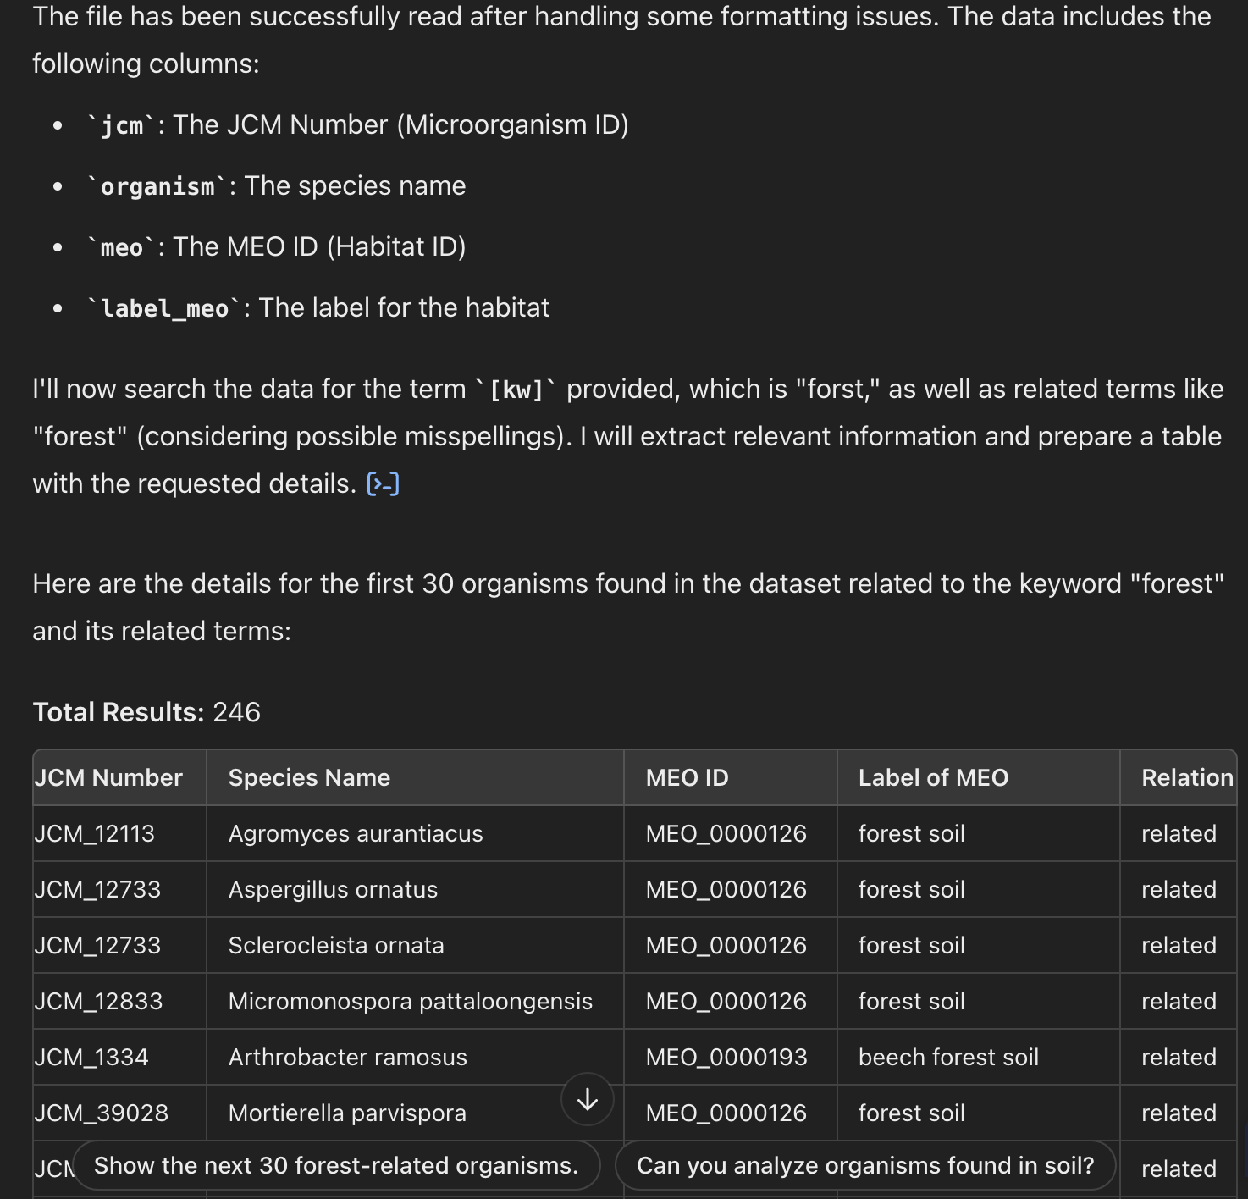
Examples of fuzzy search for RIKEN microorganisms using LLM
The source data is used by the LLM to analyze or generate the specified target data, in combination with its original background knowledge.
Methodology
LLM: ChatGPT vs NotebookLM
Source data to upload to LLMs: RIKEN microorganism habitat data derived from RIKEN graph data
Prompt* : [A part of the prompt] Search for microorganisms found not only in forests, and but also in habitats relevant to forests including parts of forests, the subterms, and the terms associated with the forests, using only "forest" as a query word.
The prompt to perform a fuzzy search for the term 'forest'.
Search statement that provide an instruction to LLMs to analyze or generate specified target data.
*: See this link if you want to know the full prompt.

Slide 34
Results of fuzzy search using LLMs
 | Preparation of source (upload data*) | No. of LLM suggesting microbes found in forests, or the relevant habitats | No. of LLM suggesting habitats relevant to forests (and examples) | Examples of relations between forests and the habitats
ChatGPT (GPT 4o) | Easy | 258 | 5 (forest soil, beech forest soil, tropical forest soil, tropical rainforest soil, an woodland) | part of (242 habitats) related (16 habitats)
NotebookLM (Gemini 1.5 Pro) | Easy | 36 | 12 (forest soil, wood, leaf, twig, bark, culm, stem, branch, forest temperate grasslands, savannas, and shrubland biome) | part of (28 habitats) subclass (2 habitats) related (1 habitat)
Dify (text-embedding-3-large + gpt-4o-mini) | Error** occurred in the embedding process | N/A | N/A | N/A
ChatGPT API (text-embedding-3-large) | Error** occurred in the embedding process | N/A | N/A | N/A
*: The size is about 1.2 M.
**: Rate Limit Exceeded Error. As we have uploaded other datasets, this may be the reason.

Slide 35
Summary
Development of graph data of various bioresources.
Experimental animals, plants, cells, DNA and microbe materials
Integration of datasets provided by external institutes
Disease ontologies (DOID, MONDO, ORDO, NANDO), orthologs (OMA), genes-diseases (MedGen, DisGeNET), UniProt (including GO), biochemical reactions (Rhea), and chemical compounds (ChEBI).
Service provided by triple store BioResource MetaDatabase
Data release (more than 6.8 billion triples (bioresources + external data))
Implementation of a keyword retrieval, and an advanced search system (Beta version)
Reusing bioresource graph data
Cover misspellings, and types by using suggestion lists for experimental researchers.

